Slide 1
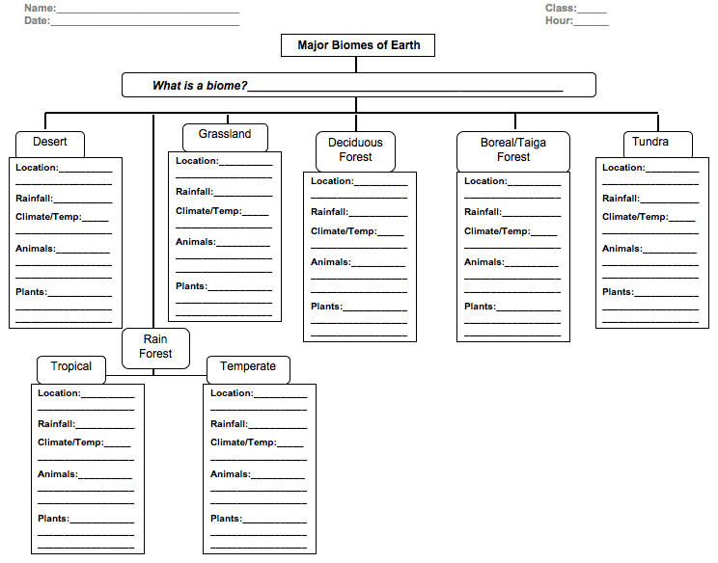

Slide 2
Color the Map as we are learning about each Biome:
Directions: Using the colors shown in the maps throughout the lesson 8.3 (pg 297-303), color the key and then use the key to color the areas on the map of the world in order to locate each biome.

